Slide 1
.NET Development Unit of Work Pattern
DATA ACCESS DESIGN PATTERNS

Slide 2
The concept
Almost all software interacts (CRUD) with a database system.
.Net developers use ORM tools like Entity Framework or Dapper to access these databases smoothly and efficiently.
BUT the concern is how to use these ORM tools to write code that is
reusable
maintainable
readable
and above all testable
This is were design patterns focus on. The repository and unit of work pattern try to solve common problems with database access and business logic transactions.

Slide 3
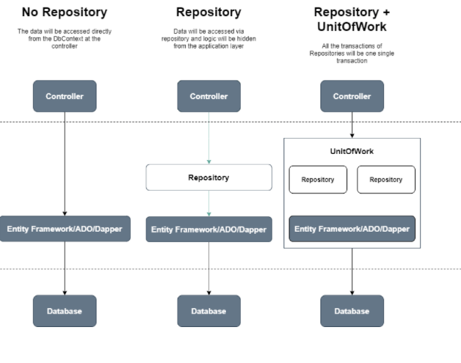
3 approaches for data access
In the course ASP.NET MVC you learned how to use Entity Framework to manage all database transactions.
The DbContext was instantiated directly in the controller to gain access to the EF DbSets.
In the previous chapter we introduced the Repository pattern. In this chapter the Unit of Work pattern is explained.

Slide 4
What is Unit of Work?
A Unit of Work acts as a business transaction.
The Unit of Work will merge all the transactions (Create/Update/Delete) of Repositories into a single transaction.
All changes will be committed only once.
They will be rolled back if any transaction fails to ensure data integrity.
People often consider the Unit of Work a lazy evaluation transaction because it will not block any data table until it commits the changes

Slide 5
Repositories without Unit Of Work
Each repository will generate and maintain its own DBContext class.
Each DBContext has its own in-memory list of changes of the entities that are being added/updated/deleted in a single transaction.
This might lead to inconsistencies when the SaveChanges request from one DbContext succeeds while the other one fails.
Movie Controller
Movie Repository with its own DbContext
Rating Controller
Rating Repository with its own DbContext
Notes:
Non-generic versus generic repository. Here non-generic → each entity has its own repository
Generic → all entities use the same repository

Slide 6
Repositories with Unit of Work
To avoid inconsistent transactions, we will add another layer between the controller and the repositories.
This layer will act as a centralized store for all the repositories to receive the same instance of the DbContext.
This will ensure that, for a unit of transaction that spans across multiple repositories, it should either complete for all entities or should fail and rollback entirely.
UnitOfWork class provides DbContext instance
Movie Repository receives DbContext
Movie Controller
Rating Controller
Rating Repository receives DbContext
Notes:
In the above representation, during a single operation, that involves Movie and Rating entities, both of them use the same DbContext instance. This will ensure that even if one of them breaks, the other one is also not saved, thus maintaining the database consistency. So when SaveChanges is executed, it will be done for both of the repositories.

Slide 7
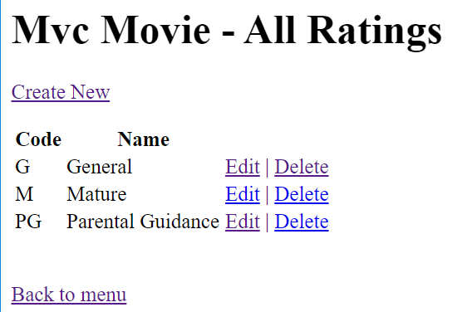
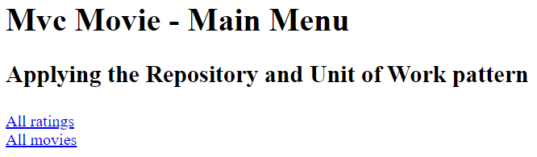
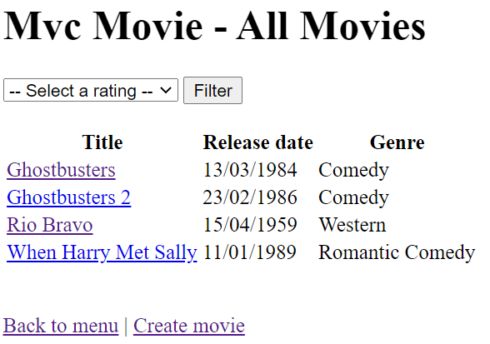
Demo
Open the solution “MVCMovieDemo UoW Start”
Run the application.
Notes:
This start application is the end of the repository pattern app

Slide 8
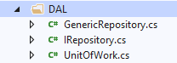
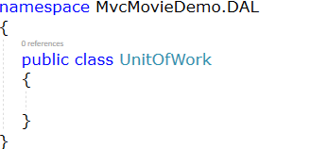
Create UnitOfWork class in DAL
DAL | Add new item | Class ‘UnitOfWork’

Slide 9
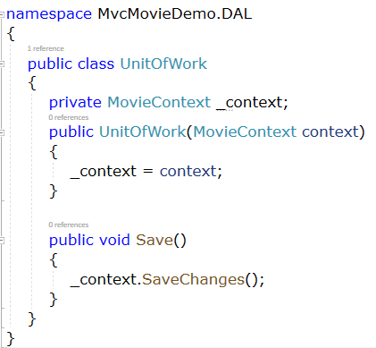
Create UnitOfWork class in DAL
The unit of work class serves one purpose: to make sure that when you use multiple repositories (Movies/Ratings), they share a single database context.
That way, when a unit of work is complete you can call the SaveChanges method on that shared instance of the context and be assured that all related changes will be committed or rolled back.

Slide 10
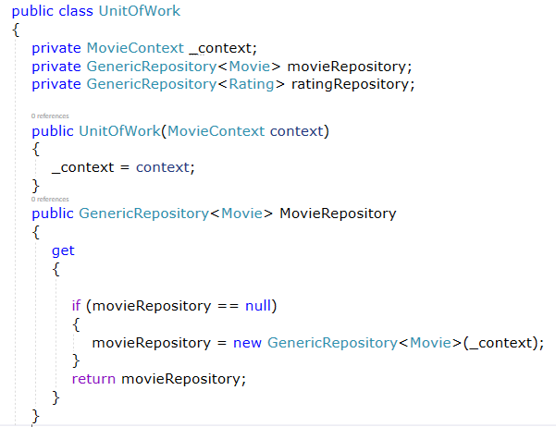
Create UnitOfWork class in DAL
Furthermore, the class needs a getter for each repository.
Each repository property returns a repository instance that has been instantiated using the same database context instance as the other repository instances.
MovieRepository
Notes:
Each repository property checks whether the repository already exists. If not, it instantiates the repository, passing in the context instance. As a result, all repositories share the same context instance.

Slide 11
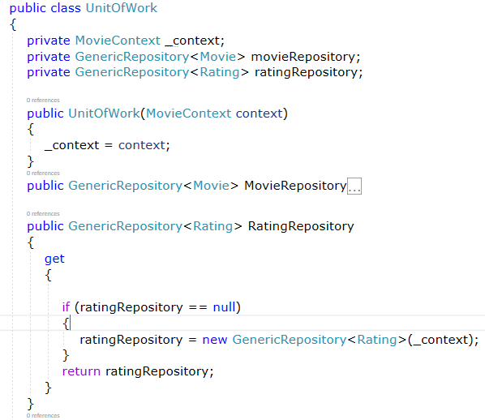
Create UnitOfWork class in DAL
Furthermore, the class needs a getter for each repository.
Each repository property returns a repository instance that has been instantiated using the same database context instance as the other repository instances.
RatingRepository
Notes:
Each repository property checks whether the repository already exists. If not, it instantiates the repository, passing in the context instance. As a result, all repositories share the same context instance.

Slide 12
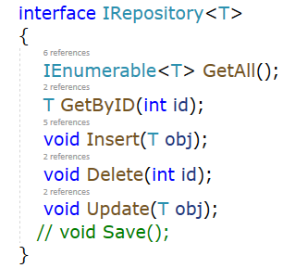
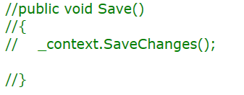
Change IRepository & GenericRepository class
The UnitOfWork class controls now all the changes to the database. The repositories don’t need a Save method anymore.

Slide 13
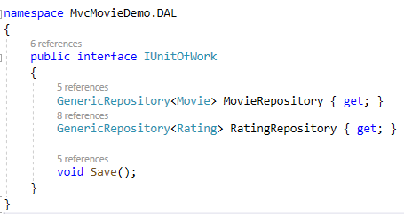
Create IUnitOfWork interface in DAL
Because of DI and testability we want to create an interface for this UnitOfWork class.
We will inject this interface in our ASP.NET MVC Controllers later on.

Slide 14
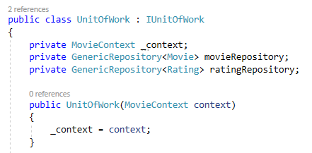
Implement the IUnitOfWork interface

Slide 15
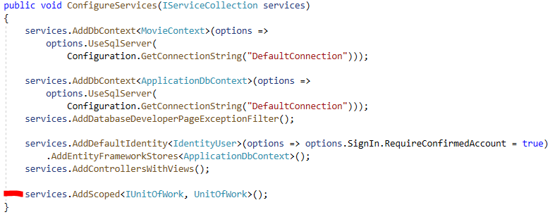
Register IUnitOfWork as a dependency
Startup.cs – ConfigureServices

Slide 16
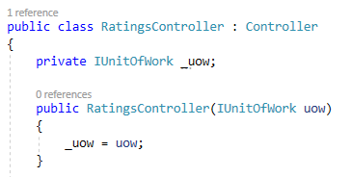
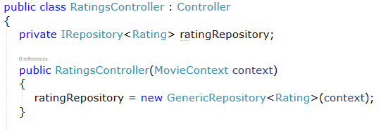
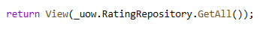
Change the RatingsController to use the UnitOfWork class
From
To
In every ActionMethod the ratingRepository is called directly
Now, the ratingRepository is called starting from the unitOfWork object we get from the DI container.

Slide 17
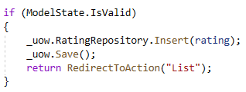
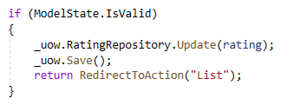
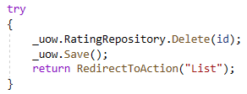
Change the RatingController to use the UnitOfWork class
After every CUD action the Save method from the UnitOfWork instance is called

Slide 18
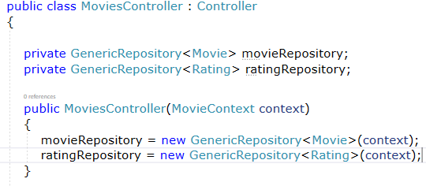
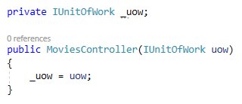
Change the MovieController to use the UnitOfWork class
From
To
In every ActionMethod the ratingRepository & movieRepository are called directly
Now, both the repositories are called starting from the unitOfWork object.

Slide 19
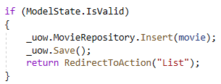
Change the MovieController to use the UnitOfWork class
In the create ActionMethod the Save method from the UnitOfWork instance is called

Slide 20
Run the application
The project runs as smoothly as before.
However, in both controllers the ‘Save’ call only refers to one entity that needs a database change.
CUD in RatingsController: DbSet<Ratings> ← → table Rating
C in MoviesController: DbSet<Movies> ← → table Movie
The purpose of the UnitOfWork pattern becomes more clear when the changes in both DbSets need to be committed to the database in one single SaveChanges-request.

Slide 21
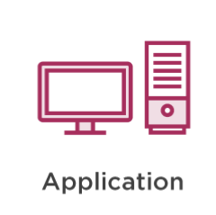
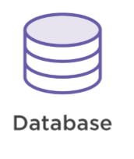
Create movie with new rating in 1 transaction
Unit of Work
Get rating
Get rating
Rating Repository
Rating entity
Rating record

Slide 22
Create movie with new rating in 1 transaction
Unit of Work
Get rating
Get rating
Rating Repository
Rating entity
Rating record
Create rating

Slide 23
Create movie with new rating in 1 transaction
Unit of Work
Get rating
Get rating
Rating Repository
Rating entity
Rating record
Create rating
Create movie
Movie Repository

Slide 24
Create movie with new rating in 1 transaction
Unit of Work
Get rating
Get rating
Rating Repository
Rating entity
Rating record
Create rating
Create movie
Movie Repository
1 transaction to the database
Save Changes
Commit changes

Slide 25
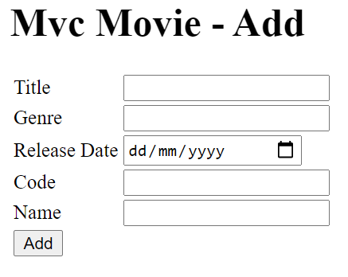
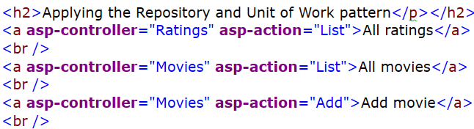
Edit views
Add an extra tag helper in Home/Index.cshtml
Add view ‘Add.cshtml’ in the Movies folder
(from resources)
Via this view a new Movie is inserted with a corresponding Rating.
When the combination rating code and name doesn’t exist a new Rating is added immediately

Slide 26
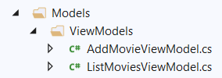
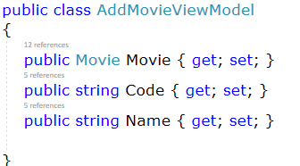
Create new ViewModel from resources
The view contains inputfields for
a Movie Entity
a string Code
a string Name
Create a new class AddMovieViewModel in folder Models/ViewModels

Slide 27
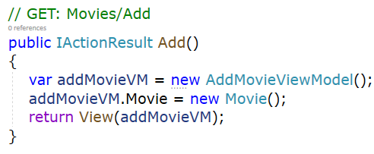
Extend MovieController (GET) from resources
Create an instance of the AddMovieViewModel class and pass it to the corresponding view

Slide 28
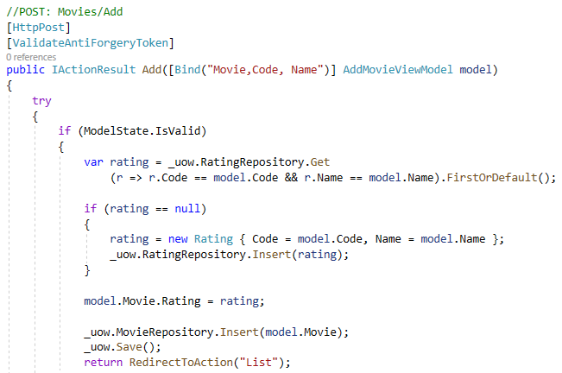
Extend MovieController (POST) from resources
New Rating in DbSet<Rating>
1 transaction to the DB unitOfWork.Save()
New Movie in DbSet<Movie>

